Slide 1
Intro to Hacking with the Raspberry Pi
Sarah Withee (@geekygirlsarah)

Slide 2































Titanium Sponsors
Platinum Sponsors
Gold Sponsors

Slide 3
Breakdown
Raspberry Pi Information
Intro to Hardware
Project 1 (LEDs) – Cylon/Knight Rider Lights
Project 2 (LCD Screen) – LCD Twitter Feed
Project 3 (Sensors) – Wall-Avoiding Robot
Other Ideas
More Information and Conclusion

Slide 4

What is the Raspberry Pi?
“The Raspberry Pi is a credit-card sized computer that plugs into your TV and a keyboard. It is a capable little computer which can be used in electronics projects, and for many of the things that your desktop PC does, like spreadsheets, word-processing and games. It also plays high-definition video. We want to see it being used by kids all over the world to learn programming.”
-- raspberrypi.org/faqs

Slide 5
What is “hacking”?
“We are taking back the term ‘Hacking’ which has been soured in the public mind. Hacking is an art form that uses something in a way in which it was not originally intended. This highly creative activity can be highly technical, simply clever, or both. Hackers bask in the glory of building it instead of buying it, repairing it rather than trashing it, and raiding their junk bins for new projects every time they can steal a few moments away.”
-- hackaday.com/about/

Slide 6
Questions
How many of you own a Raspberry Pi?
How many of you haven’t done anything with it?
How many of you have installed some server (web/file/media/etc.) and don’t really touch it?
How many of you have built projects with it?

Slide 7
Disclaimer
This IS a workshop…
for integrating the Pi into fun hacking projects…
for learning to program with sensors, LEDs, and more
for learning to build sample projects to inspire you to build your own projects

Slide 8
Disclaimer
This is NOT a workshop…
on how to use Linux
on how to install a Raspberry Pi OS
for advanced electronics
on general programming

Slide 9

very code
much resources
how to pi
total wow
www.sarahwithee.com/raspberrypi

Slide 10
Raspberry Pi Information
Intro Pi > Intro Hardware > LEDs > LCD > Robot > More Ideas > Conclusion

Slide 11
History of the Raspberry Pi
2006 – Had idea for affordable computer for kids
2008 – Processors started to get cheap enough to make it a feasible project
2011 – Model B entered mass production
2013 – Sold > 2,000,000 units
2015 – Pi 2 Model B released

Slide 12
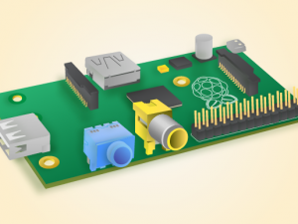
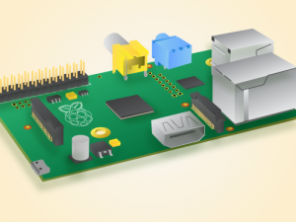
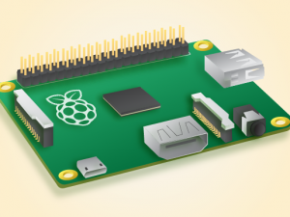
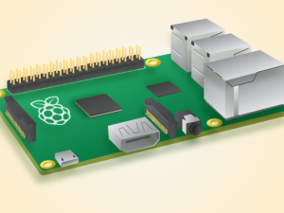
Raspberry Pi Models
 | Pi Model A | Pi Model B | Pi Model A+ | Pi Model B+ | Pi 2 Model B
Processor | 700 MHz | 700 MHz | 700 MHz | 700 MHz | 4x 900MHz
Memory | 256 MB | 512 MB | 256 MB | 512 MB | 1 GB
Expansion | Full SD | Micro SD | Full SD | Micro SD | Micro SD
USB Ports | 1 | 2 | 1 | 4 | 4
Ethernet | No | 10/100 | No | 10/100 | 10/100
A/V | HDMI, composite | HDMI, composite | HDMI, 3.5mm jack | HDMI, 3.5mm jack | HDMI, 3.5mm jack
GPIO Pins | 26 | 26 | 40 | 40 | 40
Power | 300mA*, 1.5W | 700mA*, 3.5W | 200mA*, 1W | 600mA*, 3W | 800mA*, 4W
Cost | $25 | $35 | $20 | $30 | $35
* Barebones Pi with no peripherals attached. 1.2A minimum power supply recommended.

Slide 13
Intro to Hardware
Intro Pi > Intro Hardware > LEDs > LCD > Sensors > More Ideas > Conclusion

Slide 14
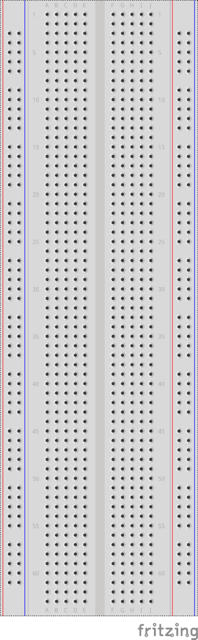
What Is a Breadboard?
A type of board used for prototyping
Each row of 5 is connected
Each column of 50 is connected
Columns on side are power rails:
Red is power
Blue is ground

Slide 15
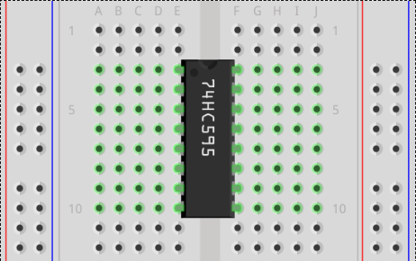
What Is a Breadboard?
Each column of holes are connected together
Each row of 5 holes are connected to each other

Slide 16
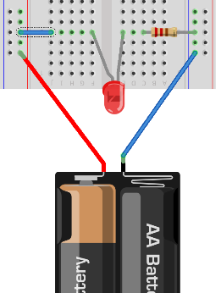
Making a Circuit
Just like middle school circuitry
Electricity must flow in a full circle from source, through elements, back to the source
Source of power is called positive terminal
Must return back to the source at negative terminal

Slide 17
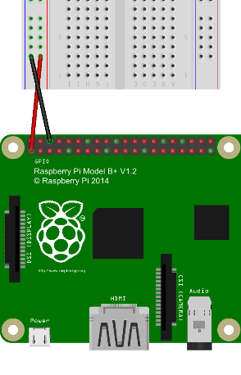
Powering Circuits
Outgoing Power:
Pi provides 3.3 volts (V) and 5 volts
Labelled as +3.3V, +5V, or Vcc
Like positive terminal on battery
Return Power:
Labelled Ground or GND
Like negative terminal on battery
Typically we wire +3.3 or +5 to red rail and GND to blue rail on breadboard

Slide 18
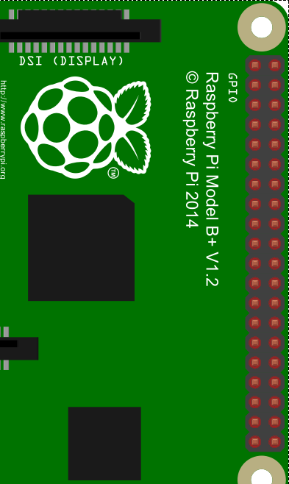
General Purpose Input/Output (GPIO)
Raspberry Pi provides:
A or B: 26 pins
A+, B+, or 2B: 40 pins
40 pins are backward compatible with 26
Multiple power and ground pins
All others are “general purpose” and are programmable
Output pins send +3.3V
Some pins have special purposes and can’t be swapped

Slide 19
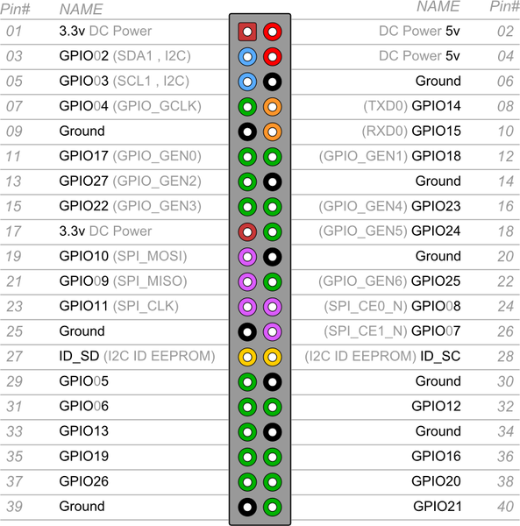
Powering Circuits

Slide 20
Programming GPIO Pins
For this talk, we’ll use Python for readability
Python libraries are already build in
At start, must set output mode:
Board – physical pin #
BCM – GPIO pin #
At end, must exit cleanly:
import RPi.GPIO as GPIO
GPIO.setmode(GPIO.BOARD)
GPIO.setmode(GPIO.BCM)
GPIO.cleanup()

Slide 21
Programming GPIO Pins
For each GPIO pin used, you must set it up as input or output first:
Write out to the output pins:
Read in from input pins:
GPIO.setup(3, GPIO.OUT) GPIO.setup(4, GPIO.IN)
GPIO.output(3, True) # +3.3V
GPIO.output(3, GPIO.HIGH)
GPIO.output(3, False) # 0V
GPIO.output(3, GPIO.LOW)
x=GPIO.input(4) # Bool or 0/1

Slide 22
Project 1 (LEDs) – Cylon/Knight Rider Lights
Intro Pi > Intro Hardware > LEDs > LCD > Sensors > More Ideas > Conclusion

Slide 23
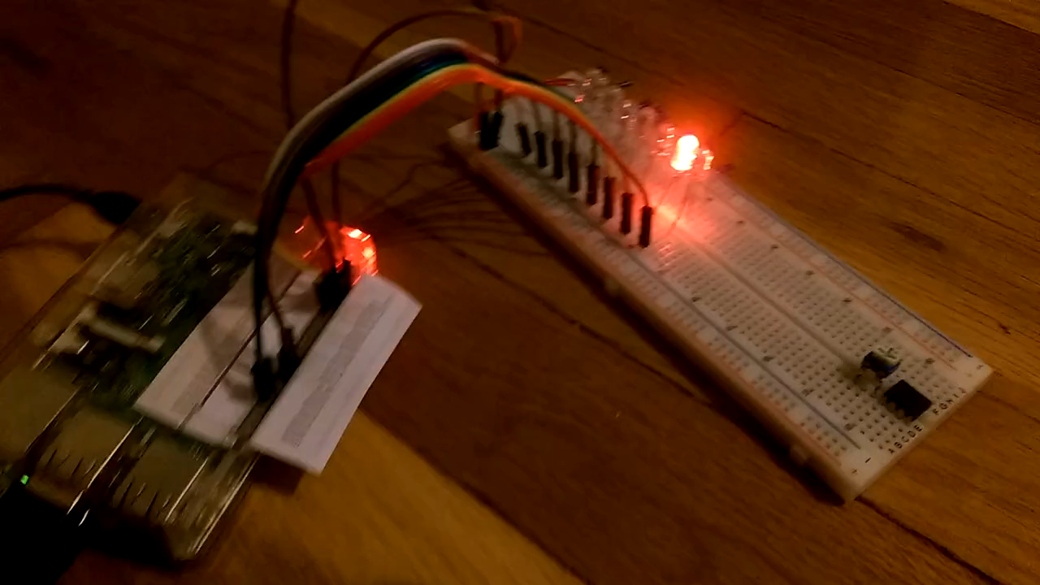
Demo

Slide 24
Materials List
Raspberry Pi (any model)
Power supply (I recommend at least 1.5A for this project)
1 Breadboard
8 light emitting diodes*
8 resistors*
9 jumper wires
* I’ll explain these in a minute

Slide 25
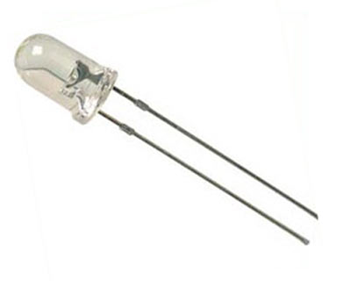
Light Emitting Diodes (LED)
Diode – Electronic device that allows electricity to flow in one direction
Anode – longer wire (+)
Cathode – shorter wire (-)
When power is applied (correctly), it glows. Otherwise nothing
Resistor needed otherwise LED will glow bright white then fry
I recommend just buying LED packs that include resistors with them

Slide 26
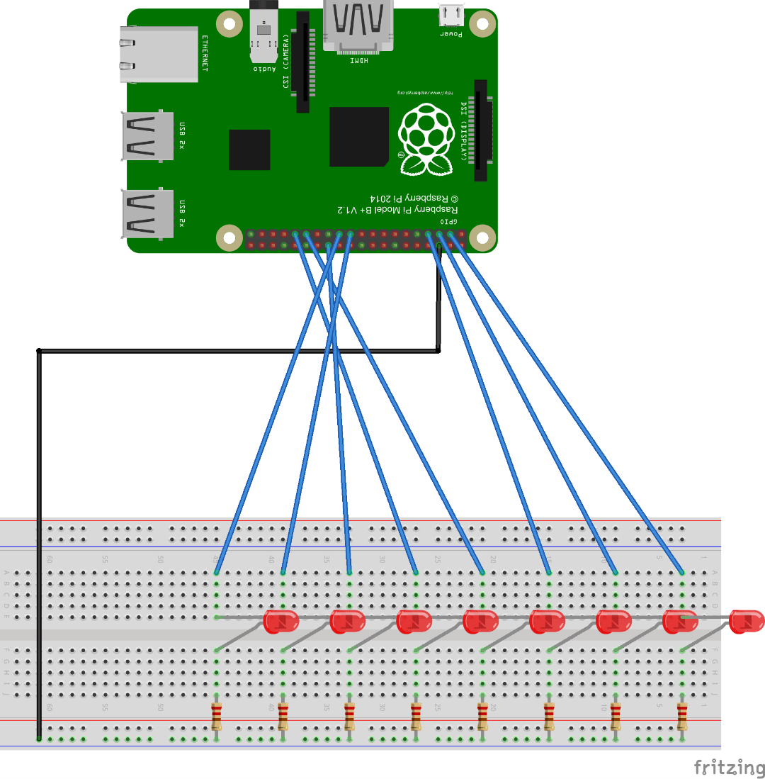
Hardware Layout
Pi GND -> blue rail
Pi GPIO 2-10 -> LED’s anodes (longer wire)
LED’s cathode (shorter wire) -> resistor
Resistors -> blue rail

Slide 27
Hardware Layout
Programmatically turn on power to blue wires
Return to GND
Through LED & Resistor
Through blue GND rail

Slide 28
Code
# Import libraries
import time
import RPi.GPIO as GPIO
# Create array of GPIO pins
pins = [3, 5, 7, 29, 31, 26, 24, 21]
# Speed lights will blink (secs)
speed = .2

Slide 29
Code
# Set GPIO pins to board (physical pins) mode
GPIO.setmode(GPIO.BOARD)
# Set up all pins as output pins
for i in pins:
GPIO.setup(i, GPIO.OUT)

Slide 30
Code
while True:
for i in range(len(pins)):
GPIO.output(pins[i], True)
time.sleep(speed)
GPIO.output(pins[i], False)
for i in range(len(pins)-1, -1, -1):
GPIO.output(pins[i], True)
time.sleep(speed)
GPIO.output(pins[i], False)

Slide 31
Demo

Slide 32
Project 2 (LCD Screen) – LCD Twitter Feed
Intro Pi > Intro Hardware > LEDs > LCD > Sensors > More Ideas > Conclusion

Slide 33
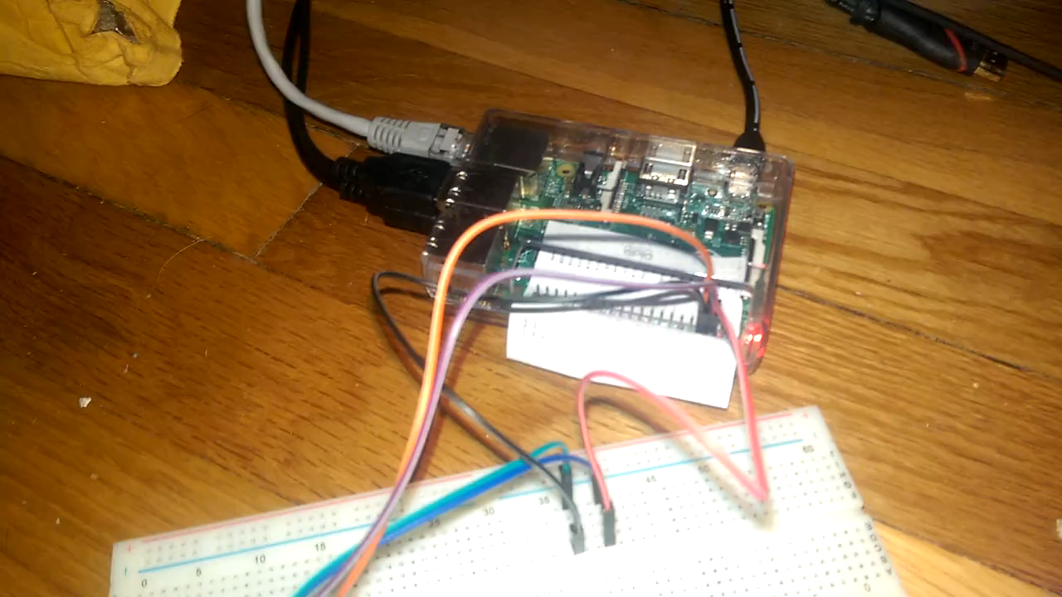
Demo

Slide 34
Materials List
Raspberry Pi and power supply
4 jumper wires
1 Breadboard (needed if you don’t have right wires)
1 LCD screen
They vary in size/shape/color/etc. Use one with I2C or Serial capabilities

Slide 35
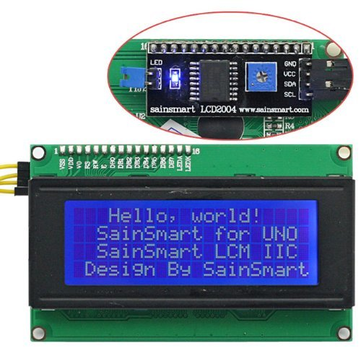
LCD Screen
Uses 4x20 characters per screen
Each character is 8x5 pixels
Can add custom characters
Really easy to use with serial or I2C chip on the back
Does have small delay when writing/erasing screen

Slide 36
I²C
Inter-Integrated Circuit
Communications protocol for circuitry
Uses master/slave bus
Each device has an address and can be contacted by it
Communication shares the same 2 wires for all devices connected: SDA, SCL
A lot of support is built into various hardware (Raspberry Pi, Arudinos, Beaglebones, etc.)

Slide 37
I²C
Must be enabled in Raspberry Pi first
Run:
sudo raspi-config
Choose Advanced options
Choose I2C
Choose to enable it
Choose to enable it on startup

Slide 38
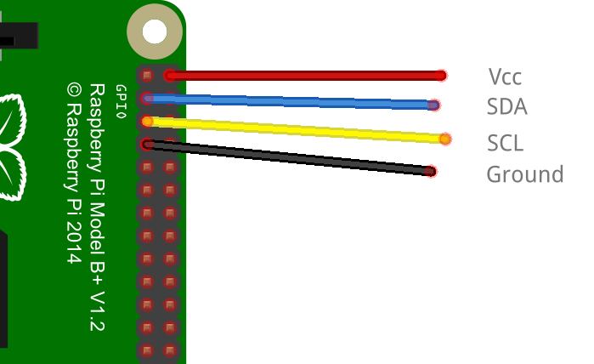
Wiring
No breadboard needed if using female-to-female wires
Use breadboard as jumping point otherwise
Raspberry Pi | LCD Screen
+5V | Vcc
SDA (pin 3) | SDA
SCL (pin 5) | SCL
Ground | Gnd

Slide 39
Code
# Requires RPi_I2C_driver.py for I2C and LCD
import RPi_I2C_driver
from time import *
# Create the object
mylcd = RPi_I2C_driver.lcd()

Slide 40
Code
# Print happy welcome message on lines 1 and 3
mylcd.lcd_display_string("Welcome to the", 1)
mylcd.lcd_display_string(“Kansas City Dev”, 3)
mylcd.lcd_display_string(“Conference!!", 4)
sleep(2) # 2 sec delay
# Erase screen
mylcd.lcd_clear()

Slide 41
Code
x = 0
y = 0
changex = 1
changey = 1

Slide 42
Code
while True:
x = x + changex
y = y + changey
if x < 1:
changex = 1
x = 1
if x >= 4:
changex = -1
if y < 1:
y = 0
changey = 1
if y >= 19:
changey = -1

Slide 43
Code
mylcd.lcd_clear()
mylcd.lcd_display_string_pos("o", x, y)
sleep(.5)

Slide 44
LCD Twitter Feed
from twython import Twython
APP_KEY = '...'
APP_SECRET = '...'
twitter = Twython(APP_KEY, APP_SECRET, oauth_version=2)
ACCESS_TOKEN = twitter.obtain_access_token()
twitter = Twython(APP_KEY, access_token=ACCESS_TOKEN)

Slide 45
LCD Twitter Feed
tweets = twitter.search(q='#KCDCpi')
print(tweets["u'statuses'"][0]["u'user'"]["u'screen_name'"])
print(tweets["u'statuses'"][0]["u'text'"])

Slide 46
Demo

Slide 47
Project 3 (Sensors) – Wall-Avoiding Robot
Intro Pi > Intro Hardware > LEDs > LCD > Sensors > More Ideas > Conclusion

Slide 48
So…
… it’s not fully finished... ☹
… but I’ll go over it anyway… ☺

Slide 49
Materials List
Raspberry Pi and power supply
Chassis of some sort
1 Breadboard
1 ultrasonic sensors (HC-SR04)
Motor controller
Some form of battery pack for motors and Pi

Slide 50
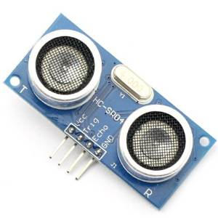
Ultrasonic Sensor
Ultrasonic sensors are one of a variety of sensors you can use
They detect distance with sound
Ultrasonic = outside of human hearing range
Pulses 40KHz signal from “T” side
“R” side listens for it
Time taken in between is time for sound to travel

Slide 51
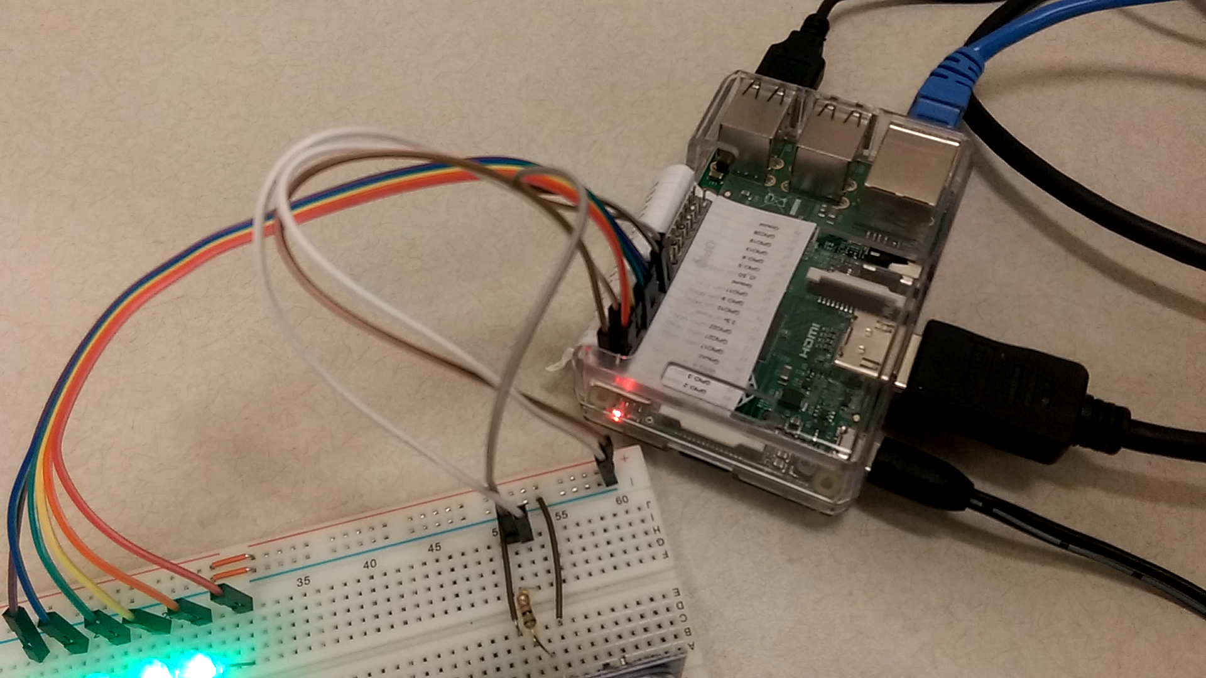
Demo

Slide 52
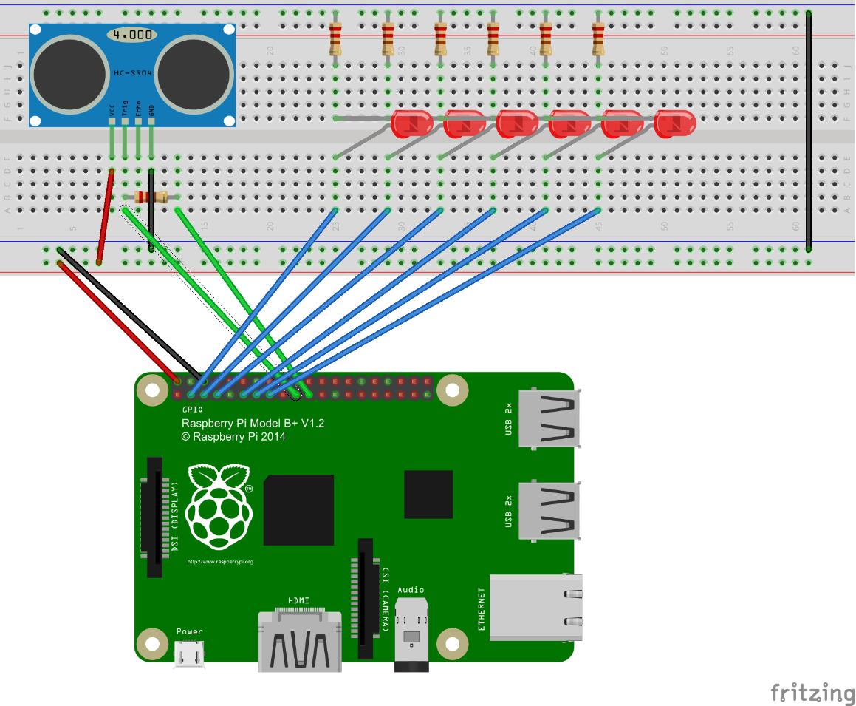
Wiring
Breadboard Ground -> Pi Ground
Breadboard +5V -> Pi +5V
Sensor Gnd -> Gnd rail
Sensor +5V -> +5V rail
LEDs similar to Project 1

Slide 53
Wiring
LED anodes to pins 3, 5, 7, 11, 13, 15 (9 is a ground, skip it)
Sensor Trigger to 19
Sensor Echo to 21

Slide 54
Code
import time
import RPi.GPIO as GPIO
# Set up the pins
uTrig = 19
uEcho = 21
leds = [3, 5, 7, 11, 13, 15]
GPIO.setup(GPIO.BOARD)
for i in leds:
GPIO.setup(i, GPIO.OUT)
GPIO.output(i, GPIO.LOW) # off

Slide 55
Code
def reading(trigger, echo):
GPIO.setmode(GPIO.BOARD)
GPIO.setup(trigger, GPIO.OUT)
GPIO.setup(echo ,GPIO.IN)
GPIO.output(trigger, GPIO.LOW)
time.sleep(0.3)

Slide 56
Code
GPIO.output(trigger, True)
time.sleep(0.00001)
GPIO.output(trigger, False)
signaloff = 0
while GPIO.input(echo) == 0:
signaloff = time.time()

Slide 57
Code
signalon = 0
while GPIO.input(echo) == 1:
signalon = time.time()
timepassed = signalon - signaloff
distance = timepassed * 17000
return distance

Slide 58
Code
# Main program
while True:
# Grab a reading
read = reading(uTrig, uEcho)
for i in range(0, 6):
print(i)
if read > i * 3:
GPIO.output(leds[i], GPIO.HIGH)
else:
GPIO.output(leds[i], GPIO.LOW)

Slide 59
Demo

Slide 60
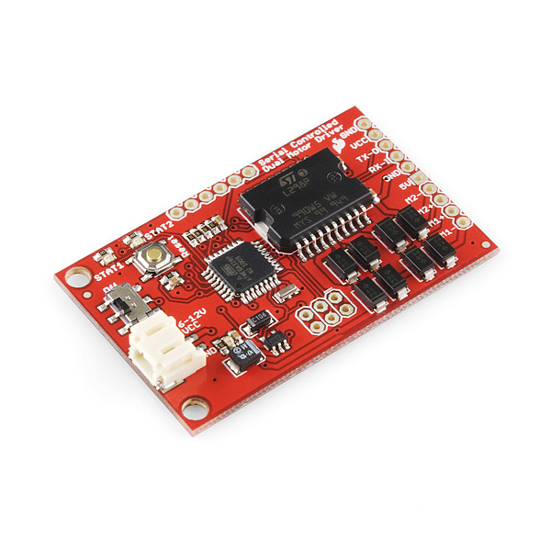
Motor Driver/Controller
Pi’s pins don’t provide enough power
Need secondary power source
Motor controller takes commands to control power to motors

Slide 61
More Information and Conclusion
Intro Pi > Intro Hardware > LEDs > LCD > Sensors > More Ideas > Conclusion

Slide 62
More Project Ideas
Customized cookie maker machine
Tracking cat/dog door
Show tweets/emails on LCD screen
AI-programmed remote control cars
Robots… of any variety…
Turn on/off heater/AC when a room is occupied/unoccupied
Ruby-based garage door opener
Chicken coup protection device

Slide 63
More Project Ideas
Customized cookie maker machine
Tracking cat/dog door
Show tweets/emails on LCD screen
AI-programmed remote control cars
Robots… of any variety…
Turn on/off heater/AC when a room is occupied/unoccupied
Ruby-based garage door opener
Chicken coup protection device
THE POSSIBILITIES ARE ENDLESS!!

Slide 64
Buying Parts
Where can I buy parts?
Raspberry Pi
Power supply – Amazon (mine’s 3.5A), $19
Breadboard – MicroCenter, $6
LEDs – Amazon or electronic stores (find set with LEDs and resistors together), $6 for 50
Ultrasonics (HC-SR04) – Amazon, $25 for 5
…

Slide 65
Resources
Raspberry Pi site: raspberrypi.org
Hack A Day: hackaday.com/

Slide 66
Lessons Learned
Don’t plan a conference talk while still a very active student
Hardware sometimes fails randomly. If software quits working, try testing the hardware
Development always takes longer than you expect it to. Hacking projects are the same.

Slide 67
Conclusion
Raspberry Pi is more than just a PC, it can interface with other electronics
You’ve seen some sample projects
You’ve seen how to code items like sensors, LCD screens, and LEDs
Hopefully you’re inspired to use these ideas to do your own projects

Slide 68
Contact Me
Twitter: @geekygirlsarah
Email: sarah@sarahwithee.com
Slides/Resources: sarahwithee.com/raspberrypi
Feel free to contact with questions or to show off projects
Check out the projects before you leave!

